Slide 1
Basic Networking HTTP

Slide 2
Module Outline
Objectives
On completing this module, you will be able to:
Demonstrate an understanding of some fundamental concepts of networking
Demonstrate an understanding of HTTP Methods
Topics
Networking Basics
IP, hostname, port number, localhost; ping;
DNS, DHCP, gateway, load balancer, NAT;
HTTP Methods

Slide 3
Networking Basics

Slide 4
Purpose of the Network
Machine
A
Machine
B
Network Protocol Stack
Notes:
The stack comprises many communication protocols at various layers: cf. https://en.wikipedia.org/wiki/Internet_protocol_suite
HTTP, FTP
TCP, UDP
IP
Ethernet
Network card
Network cable

Slide 5
IP Address
Machine A
Machine B
subnetwork
(private / internal / local network)
192.168.128.75 192.168.0.101
(Host IPs in home network)
Gateway
Internet/Network
Gateway
subnetwork
(private / internal / local network)
10.4.4.38 10.10.16.18
(Host IPs in SMU network)
Machine C
Machine D
Notes:
Each machine may belong to multiple (sub)networks at the same time. It can have multiple IP addresses at the same time too. And, different machines in different (sub)networks can have the same IP address at the same time.
Broadly speaking, two machines can communicate with each other as long as they have a way to identify each other in a network. But in reality, there are many other factors in play that may affect the communication, e.g., firewalls installed on the machines and in the network may block the communication; the machines may belong to different (sub)networks and they don't recognize each other's IP; etc.

Slide 6
IP Address
Unique Identification of
A machine (also called a host) on the network
IPv4: 4-byte numbers separated by '.' E.g., 10.10.16.18, 172.16.100.145, 192.168.0.101, 202.161.55.11
DNS (Domain Name System)
Act as a host-name registry on the network
Map host names to IP addresses
CMD window on Windows
ipconfig
To check addresses
hostname
To check hostname
Static vs Dynamic address
Notes:
IPv6 addresses have 16 bytes

Slide 7
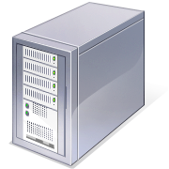
DHCP (Dynamic Host Configuration Protocol)
ipconfig /all
To check DHCP server, DNS server, Gateway, etc.
Assign IP
Local Area Network (LAN)
DHCP Server
Assign IP

Slide 8
Ping
Ping is a tool used to test whether a particular host/machine is reachable across a network
The program sends packets to the target host and listens for reply from the target
In labs, you may need to use ping to troubleshoot, to see if a remote machine can be reached
Example
ping google.com
ping 10.10.15.17

Slide 9
Loop Back Address
127.0.0.1 is the standard IP address referring to the current host
If a program tries to connect to 127.0.0.1, it is immediately looped back to the machine that currently runs the program
Usually used for testing purposes, where you do not have another machine for conducting the test
We may use this address in some labs in this course
This is also called localhost

Slide 10
Port Numbers
POP3 (110)
SMTP (25)
Process2
Process1
Email Server
Ports are used to identify a particular process/application running on a machine so that the data sent to the machine can be relayed to the right application
It is often present in some header of a network data packet; but can be omitted if using the standard ones
E.g., http://google.com:80

Slide 11


HTTP Request-Response
HTTP Request
HTTP Connection
URLs
HTTP Response
HTTP Client
HTTP Server
(Web Server)
Commonly used HTTP Request Methods | Intended meaning
POST | Create data on the server
GET | Retrieve data from the server
PUT | Update data on the server
DELETE | Delete data from the server
Notes:
"Request-Reply" is often used as a synonym of Request-Response; both are abbreviated as RR.
A client doesn't need to know the language or platform used to implement the server, as along as it knows the URLs and how to send http request and receive http reply.
A client doesn't have to be a web browser.
We'll learn using python and its built-in "requests" module to send HTTP requests and receive responses.

Slide 12
Sample Message Formats - HTTP Request & Response (GET)
URL | GET http://localhost:5000/book/9781129474251
Request | GET /book/9781129474251 HTTP/1.1 Host: localhost:5000
Response | HTTP/1.0 200 OK Content-Type: application/json Content-Length: 103 Access-Control-Allow-Origin: * Server: Werkzeug/0.16.0 Python/3.7.4 Date: Sun, 29 Dec 2019 16:01:11 GMT { "availability": 2, "isbn13": "9781129474251", "price": 21.5, "title": "SQL in Nutshell" }
Notes:
Basic knowledge about the syntax of URLs: https://en.wikipedia.org/wiki/URL: scheme ":" ["//" [userinfo "@"] hostname or IP address [":" port]] /path/ ["?" query] ["#" fragment]

Slide 13
Sample Message Formats - HTTP Request & Response (POST)
URL | POST http://127.0.0.1:5000/book/9781449474453400
Request | POST /book/9781449474453 HTTP/1.1 Content-Type: application/json Host: 127.0.0.1:5000 { "title": "Tale of Zelda", "price": 33.40, "availability": 21 }
Response | HTTP/1.0 400 BAD REQUEST Content-Type: application/json Content-Length: 109 Access-Control-Allow-Origin: * Server: Werkzeug/0.16.0 Python/3.7.4 Date: Sun, 29 Dec 2019 16:11:32 GMT { "code": 400, "data": "9781449474453", "message": "A book with the isbn13 has already existed." }

Slide 14






Load Balancer
Route network traffics to different receivers and dispatch processing workloads among them
Server 1
Load Balancer
Server 2
Many different users/clients
Network
Server …
Notes:
The client/user may not need to know the actual servers’ IPs; they can communicate with the servers indirectly via intermediaries in the network, such as gateways, routers, load balancers, etc.

Slide 15
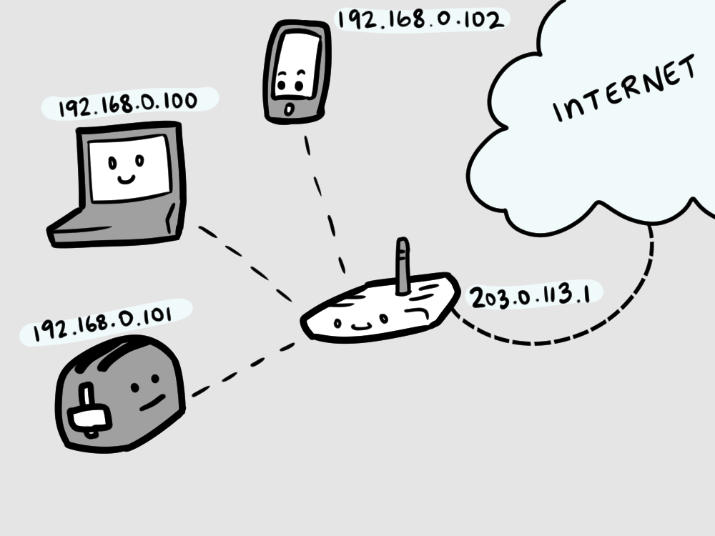
Network Address Translation (NAT)
Map one network address (e.g., an IP and a port number) to another by modifying the address information in network communication data
So that, data can be (re)routed by the network to a different receiver or can appear to come from a different sender.
E.g., the router at our home
192.168.0.1
Notes:
An IP in one network may not be accessible from Internet or another network. Network Address Translation (NAT) is one of the ways to enable communication across networks, through a device that has IPs in both networks.
How NAT Works Step by Step
Device Sends Request
A device in the private network (e.g., 192.168.1.2) sends a request to a website (example.com).
The request includes the source IP (192.168.1.2) and a randomly assigned source port (5001).
Router Modifies the Packet
The router running NAT changes the source IP to the router’s public IP (203.0.113.1) and assigns a new source port (20001).
The mapping (192.168.1.2:5001 → 203.0.113.1:20001) is stored in a translation table.
Request Reaches the Destination
The website (example.com) receives the request from 203.0.113.1:20001 and responds to this address.
Router Forwards the Response
When the router receives the response, it looks up the translation table and replaces 203.0.113.1:20001 with 192.168.1.2:5001, forwarding the packet to the correct internal device.
Why is NAT Important?
IPv4 Address Conservation
Since IPv4 addresses are limited, NAT allows multiple devices to share a single public IP address.
Security
NAT hides internal IP addresses, making it harder for external attackers to directly access devices.
Flexibility
Allows internal networks to use private IP ranges (e.g., 192.168.x.x, 10.x.x.x, 172.16.x.x) without requiring a public IP for every device.

Slide 16
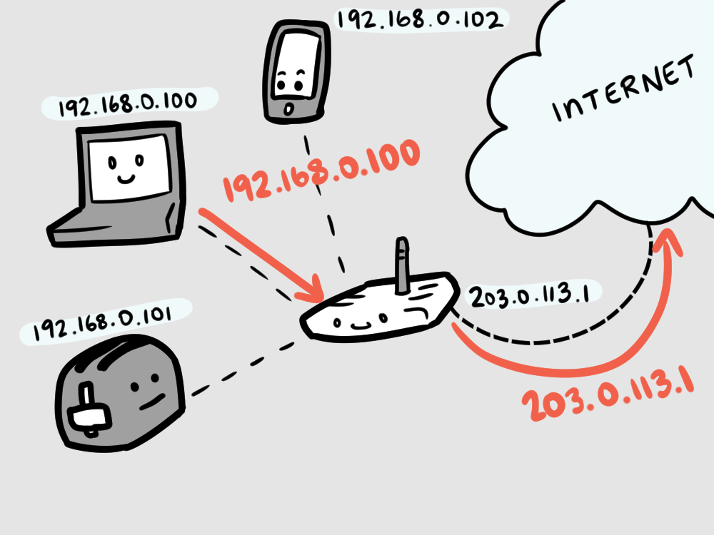
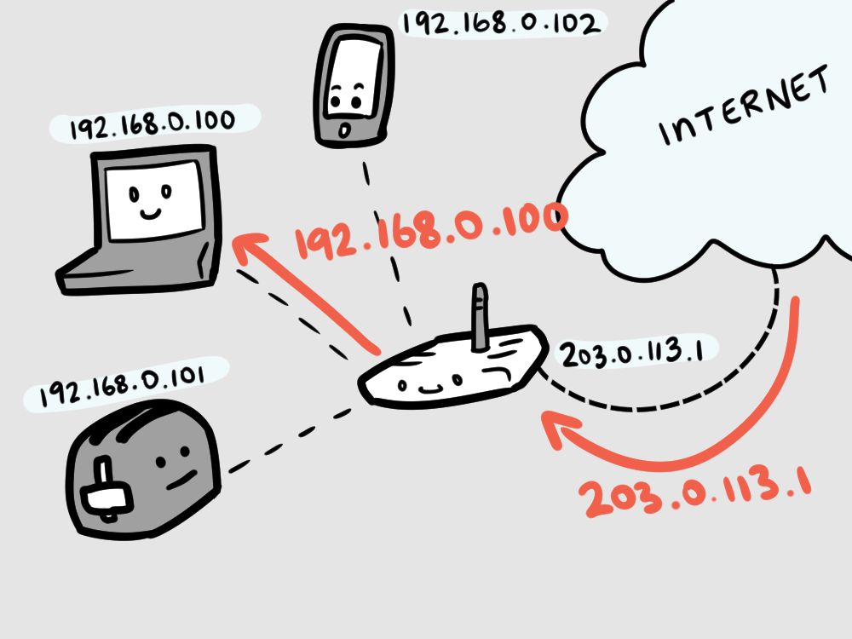
Network Address Translation (NAT) Enabled Router
Request
Reply
142.251.10.139
142.251.10.139
192.168.0.1
192.168.0.1
Courtesy of Cube Drone’s buildatheweb. Licensed under a Creative Commons Attribution-NonCommercial-ShareAlike 4.0 International License.
Notes:
The example here is for internal machines to request for external services via a NAT-enabled router, which dynamically maps IPs for each request from internal machines.
If to send a request from Internet to an internal machine, an IP/port mapping needs to be setup in the router before the request happens.
We’ll learn how to do this later for Docker containers/virtual networks.

